Slide 1
Exercise 1
Exercise #1
Modify the cities table in the pandas ipython notebook by adding a new boolean column that is True if and only if both of the following are True:
The city is named after a saint.
The city has an area greater than 50 square miles.
Note: Boolean Series are combined using the bitwise, rather than the traditional boolean, operators. For example, when performing logical and, use & instead of and.
Hint: "San" in Spanish means "saint."

Slide 2
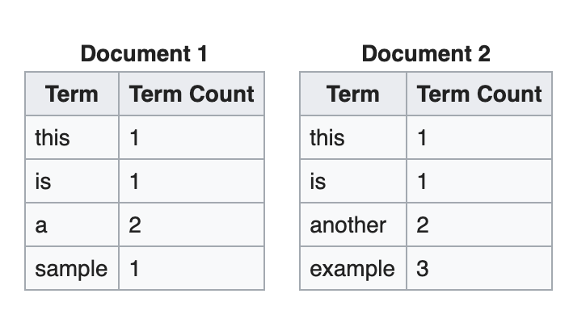
Exercise 2
Create 2 dataframes in pandas based on the information below and calculate tf-idf score for each word in document d1 and d2. The function you try to design is tfidf(w,d) where w can be any word in the vocabulary and d is either d1 and d2.

Slide 3
Exercise 3
Run eigenfaces.py
Change the number of principal components to 200, 250 and 500. Explain the changes you observe in the reconstructed output.
Read the PCA class/function in sklearn and tell the TAs the methods sklearn uses to find the eigenvectors and eigenvalues.
Fill in the blank: in PCA, given data matrix X of shape n*d where n is the number of data points and d is the dimension of the data, we calculate eigenvectors and eigenvalues of M which is ________ of X.
X is the input matrix with shape n*d where n is the number of data points and d is the dimension of the data. Lets assume Cov(X) = A^{T}A and A = f(X). Find the function f to apply on X that gives you A. Cov(X) is the covariance matrix of X.
Why do we sort eigenvalues and select eigenvectors in the decreasing order of eigenvalues.

Slide 4
Exercise 3 - Answer
Change the number of principal components to 200, 250 and 500. Explain the changes you observe in the reconstructed output.
Answer: As the number of principal components increases, the reconstructed output image quality increases.
2. Read the PCA class/function in sklearn and tell the TAs the methods sklearn uses to find the eigenvectors and eigenvalues.
Answer: The PCA function in sklearn uses linear dimensionality reduction using Singular Value Decomposition (SVD) to obtain the eigenvectors and eigen values.
3. Fill in the blank: in PCA, given data matrix X of shape n*d where n is the number of data points and d is the dimension of the data, we calculate eigenvectors and eigenvalues of M which is covariance matrix of X.
4. X is the input matrix with shape n*d where n is the number of data points and d is the dimension of the data. Lets assume Cov(X) = A^{T}A and A = f(X). Find the function f to apply on X that gives you A. Cov(X) is the covariance matrix of X.
Answer: The function f to apply on X that gives you A is X-E[X].
5. Why do we sort eigenvalues and select eigenvectors in the decreasing order of eigenvalues.
Answer: Eigenvalues represent the variance of the data. If we sort and select eigen vectors in the decreasing order of eigenvalues, we would be able to obtain the eigenvector that has the largest spread among the data first.

Slide 5
Exercise 4
Assume we need to create a model that predicts the number of customers at a restaurant at any point of time. What kind of features should we extract?
Answer: We would have to extract features such as time, location of the restaurant, number or reservations, type of food the restaurant sells, age group of the customers

